Slide 1
Teaching Circles to Play Tag
Ian Sinclair

Slide 2
Multi-Agent Q-learning Algorithm
Two agents compete with different tasks during training to maximize their own reward.
Environments are randomized so that the agents can learn adaptive policies.
Purpose: Encode the state space in the smallest way possible that still allows the agents to learn.

Slide 3
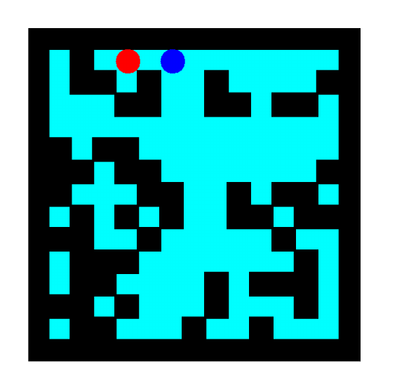
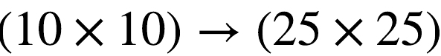

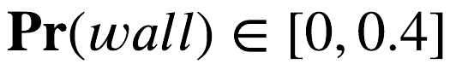
Environment
Randomly Generated 2D grid world
Size:
Walls block character movement

Slide 4
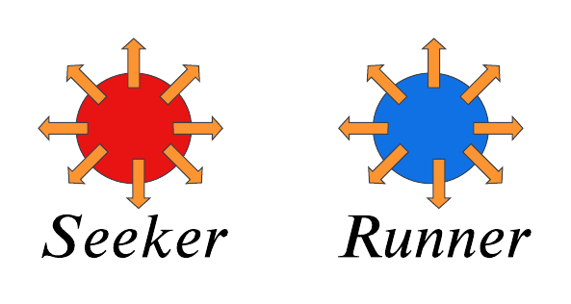

Agents
Seeker
Runner
Goal: Tag the runner by occupying the same grid tile
Goal: Avoid the seeker
The game runs for 200 steps or until the seeker tags the runner.

Slide 5
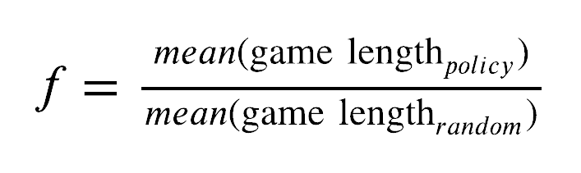
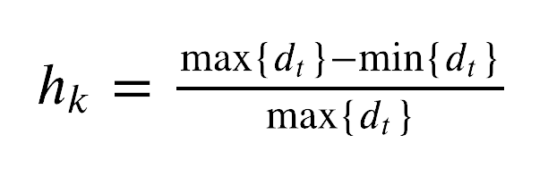

Success
A success if measured by a comparison of average game time over 1000 epocs against random collision.
High variance from random is a good indicator of learning by either the seeker or the runner.
We also consider normalized mean change in manhattan distance between the agents averaged over every 1000 games.

Slide 6





Online Q Learning
Each agent has a Q table. Which is updated online through trial and error using Bellman Equation

Slide 7
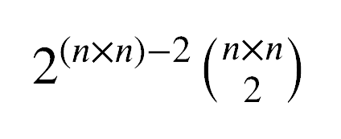
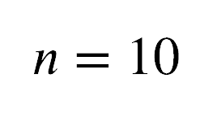
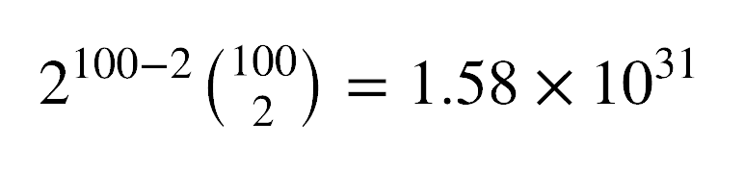
State Space
Encode the entire game board as a state
Problem: State space is to big

Slide 8
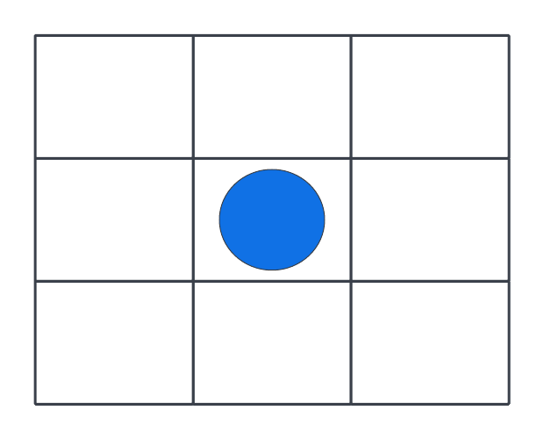
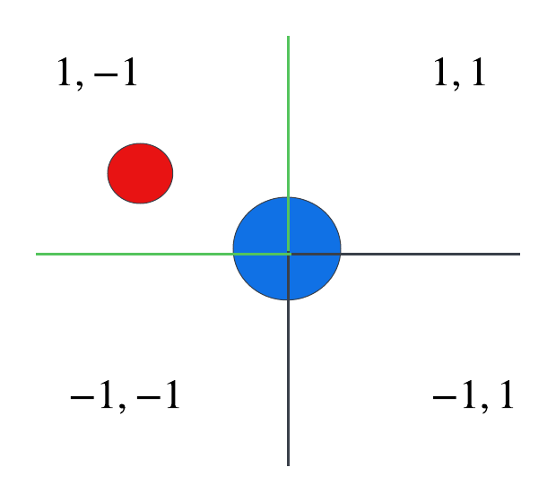
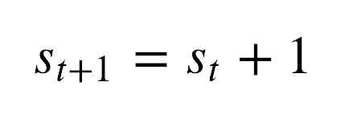
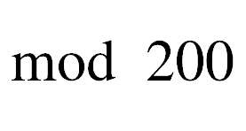
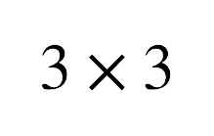
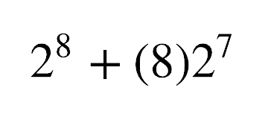

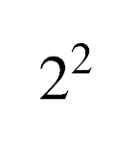
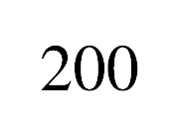
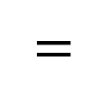
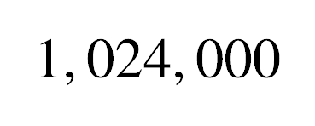
State Space
Three Decoupled Levels
Grid
Quadrant of target
Time State Decoupling

Slide 9
Results

Slide 10
Grid

Slide 11
Grid + Time Decoupling

Slide 12
Grid + Time Decoupling

Slide 13
Grid + Quadrant + Time Decoupling

